Slide 1
Healthcare Insurance Expenses
Walaa Youssef, Armando Magallan Jr,
Rocio Sampayo, Lorena Olalde Rios

Slide 2
Introduction
Healthcare insurance is a critical aspect of modern life. It provides financial protection to individuals and families in the event of illness or injury. Understanding the factors that influence healthcare insurance expenses can help insurance companies make more accurate pricing decisions and assist individuals in planning their healthcare costs.

Slide 3
Our Dashboard
The dashboard can help you predict the cost of insurance by showcasing the relationship between personal attributes, such as;
Age
Gender
Smoker
Non-Smoker

Slide 4
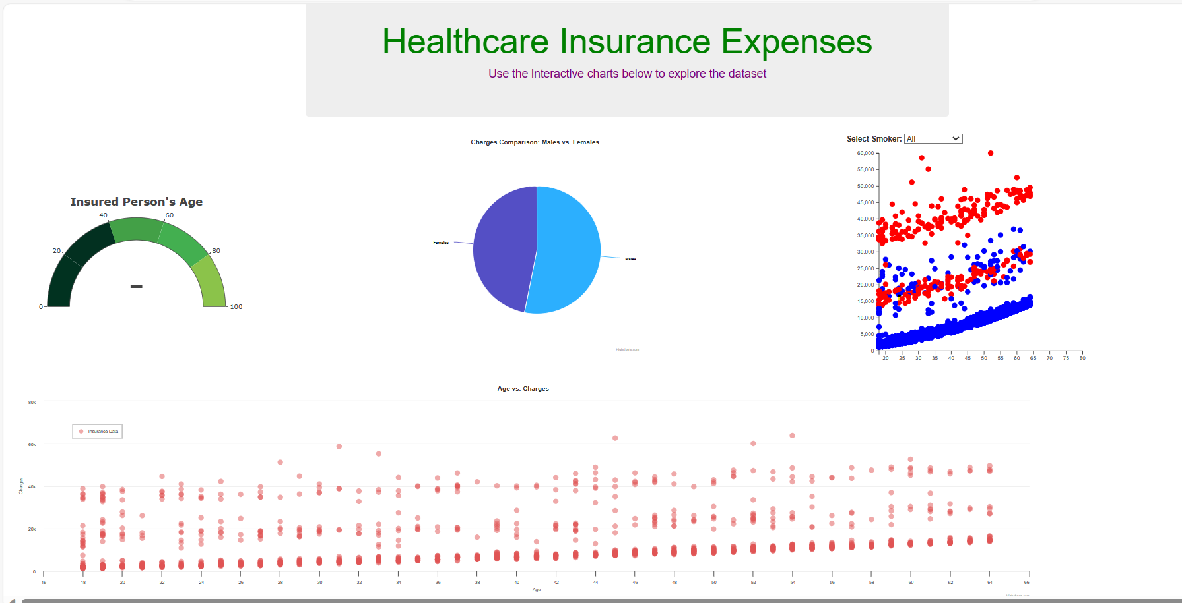

Slide 5
Project Objective
Educate insurers and individuals on the identified influencing factors such as smoking, bmi, gender, and how they contribute to healthcare insurance expenses. Empower stakeholders with knowledge and tools to make informed decisions regarding insurance coverage, and promote more fair and transparent insurance practices.

Slide 6
Process
Flask
Javascript file creation
HTML integration
Reference Highcharts Library
Created MongoDB through Jupyter Notebook

Slide 7
Interactive Aspects
When showcasing individual data, there is an integrated dropdown option that will allow the user to change the data that they are looking at.

Slide 8
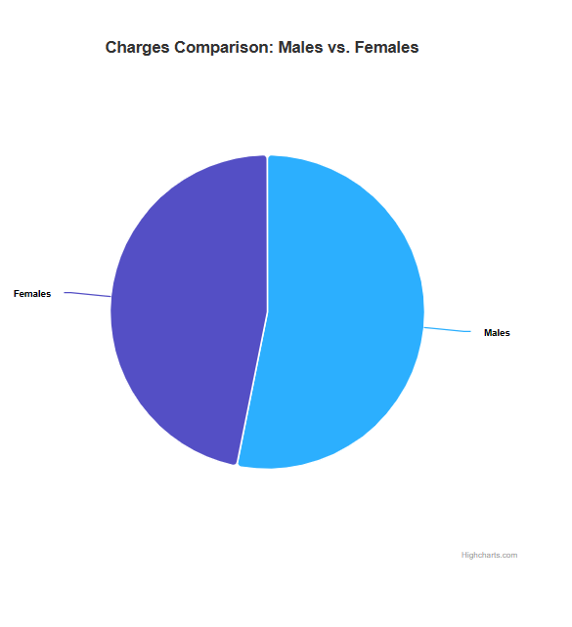
Interactive Pie Graph
This interactive feature displays the total charges for insurance for males vs the total charges for females
When you hover over the different slices, it lets you compare the data from one gender to the other

Slide 9
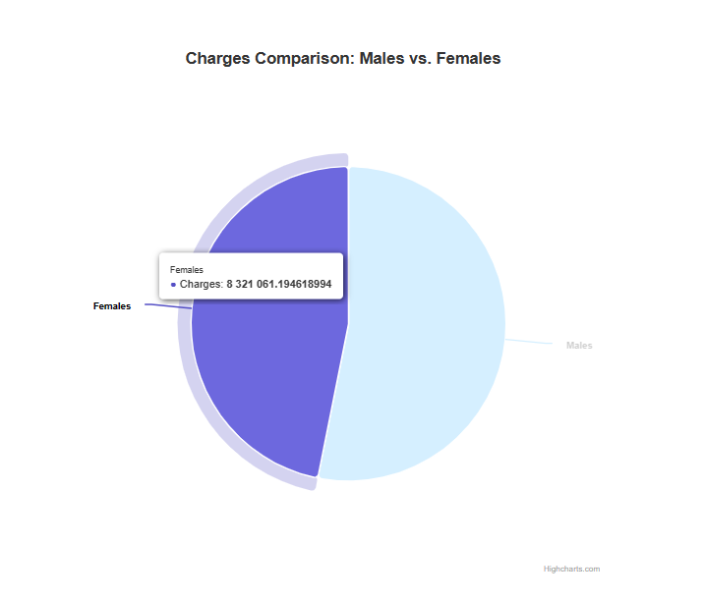
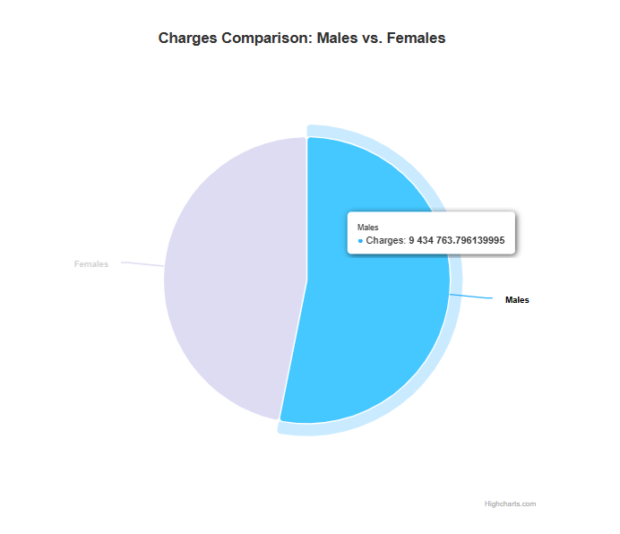
Total Charges: Males vs Females
The graphs shows Females were charged about 8.3 million for insurance vs males who were charged about 9.4 million
This shows a difference of about 1.1 million between male and females with males paying more on average

Slide 10
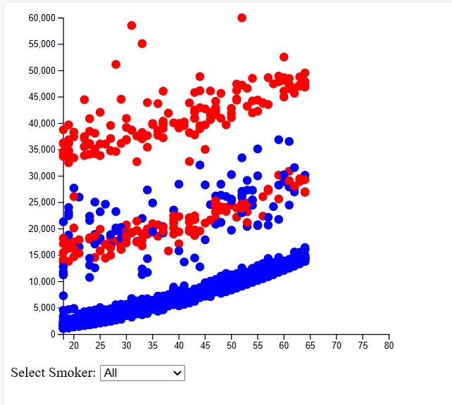
Interactive Drop Down Menu to Select Data
Drop down menu coded allows user to select whether they wish to view data for smokers, non-smokers, or a combination of them both

Slide 11
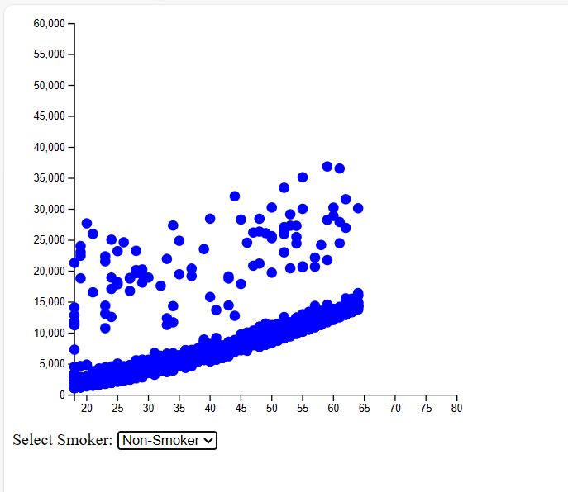
Non-Smoker data analysis
For non-smokers, there is one large cluster of data within the $2,500 to ~$15,000 range
There is also a strong positive correlation between the cost of insurance and age
A few outlier are present in the data, but a clear picture and conclusion can be drawn based on the visualization

Slide 12
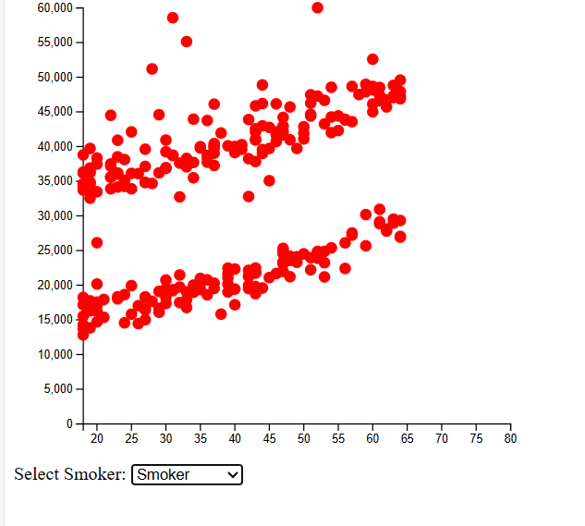
Smoker Data Analysis
For smokers, there are 2 clusters of data with one group being in the $13,000 to ~$30,000 range and the other within the $30,000 to $50,000 range
Some outliers are present, but the 2 clusters are interesting to note
It would also appear that there is a positive correlation between smoker age and cost of Insurance

Slide 13
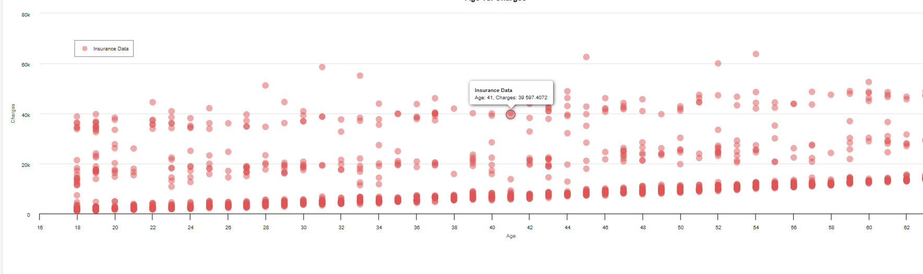
Interactive Scatter Plot Chart
Highcharts library used to create a scatter plot chart to visualize the relationship between "Age" and "Charges" based on the data loaded with D3.js

Slide 14
Trends of Age vs Insurance Charges
This interactive scatter plot shows us a positive correlation between age and total insurance charges with charges clearly increasing with older age
You can also observe a few outliers by hovering over data points on the interactive map

Slide 15
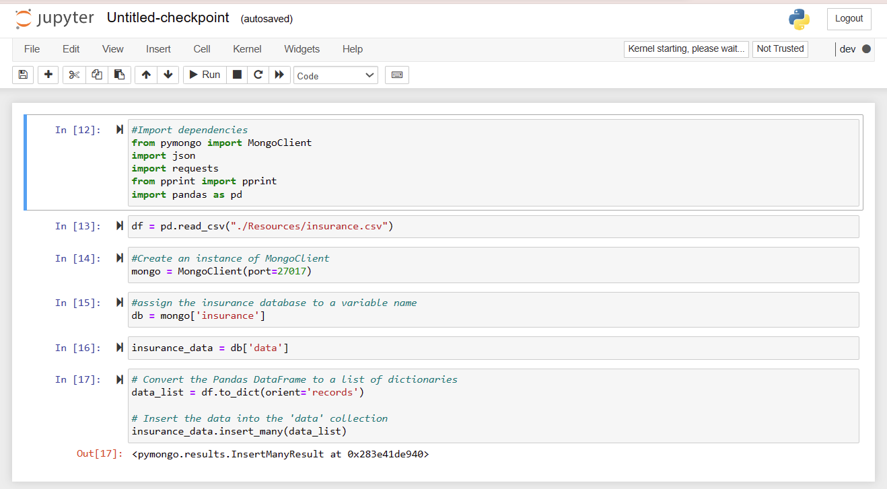
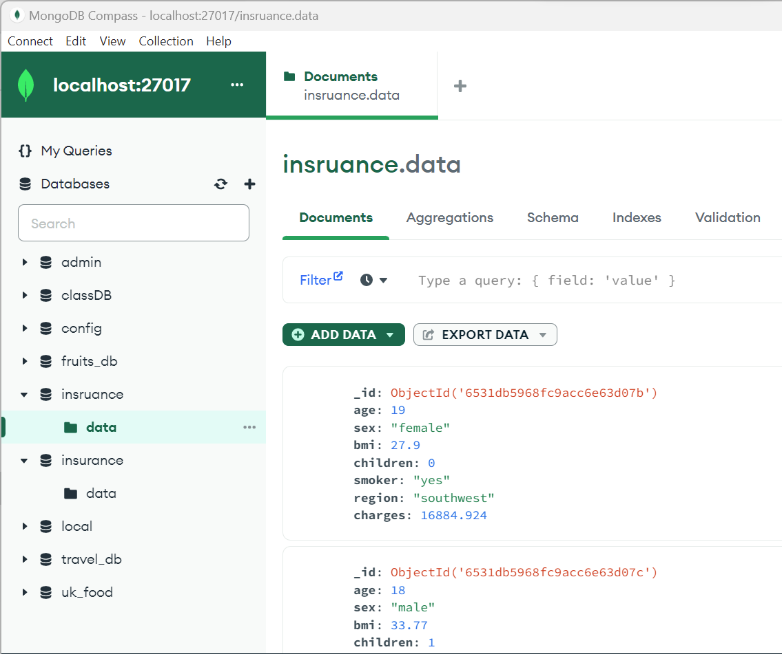
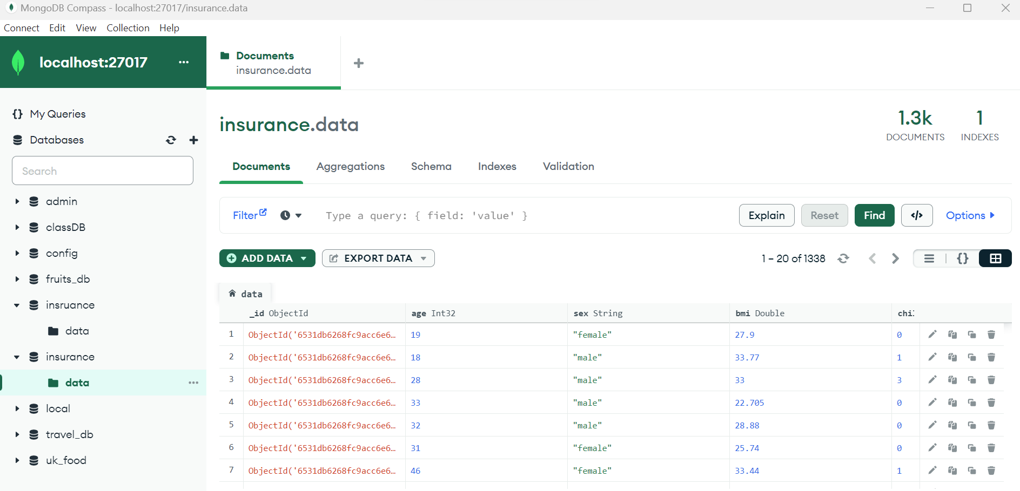
MongoDB Database created
MongoDB used to create a database with the use of Jupyter Notebook

Slide 16
Conclusion
The Healthcare Insurance Expenses Prediction project aims to provide valuable insights into the factors influencing healthcare insurance expenses, and help build a predictive model that can be used by both insurers and individuals. This project will contribute to more informed and fair healthcare insurance practices.

Slide 17
Data set / Sources
https://www.kaggle.com/datasets/arunjangir245/healthcare-insurance-expenses

